Slide 1
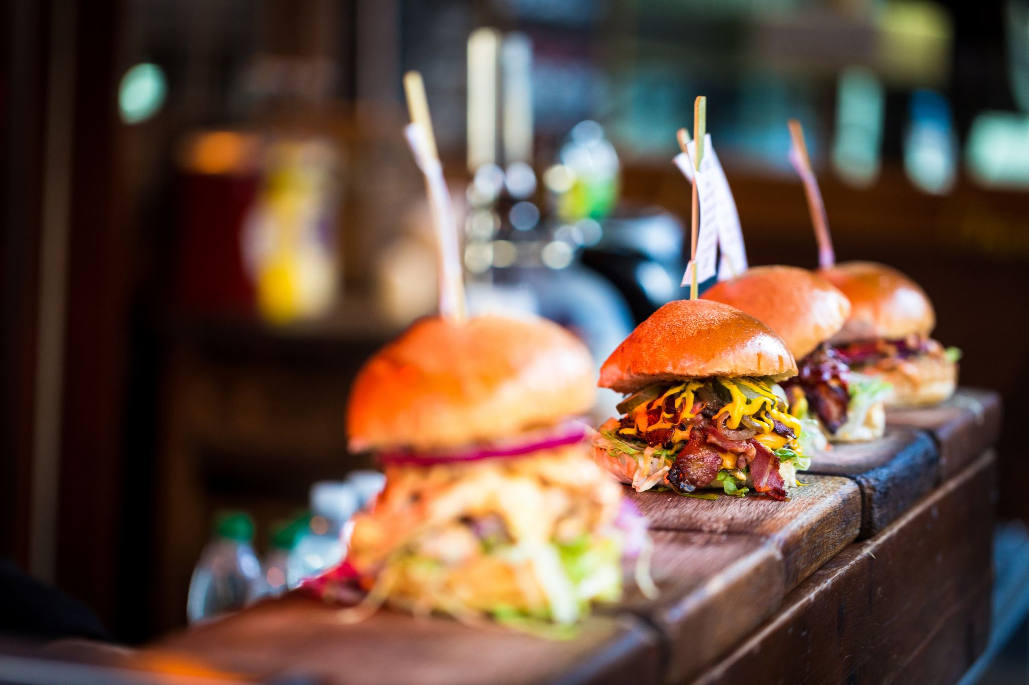
Mcdonalds and Burger King Menu EDA
Shaquiel Pashtunyar
Summer 2022 DSC 0530

Slide 2
Fast Food Menu Trends
Both McDonalds and Burger King have comprehensive menus, with burgers, fries, drinks, shakes and desserts. We want to look at the nutritional facts within each menu, the calories, grams fat, protein, sugar, fiber and more in order to identify what makes a fatty unhealthy meal.
Our hypothesis is that the amount of fat in a menu item will lead to higher amounts of Calories, but there may be a correlation with other nutritional calculations that we can find.
We are going to use an exploratory approach where we explore the data set to find trends and then home in on them to try and solve our hypothesis.

Slide 3
The nutritional facts table
First, we want to look at some of the variables in the data set, like the Chain, Serving Size, Calories, Total Fat (g), Protein (g), Items.
We can see a wide range of menu items, calorie ranges, burger to drink types, and more.

Slide 4
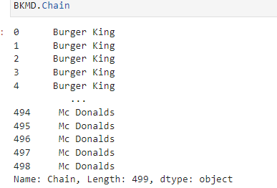
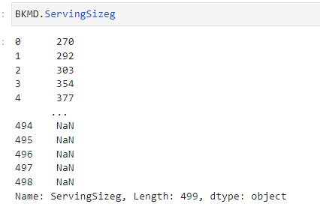
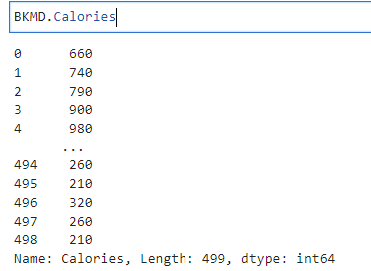
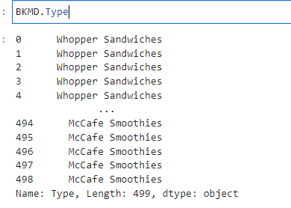
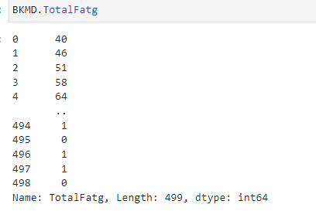
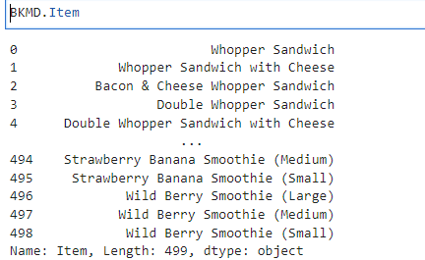

Slide 5
Histograms
In order to explore the data and understand it better we can use histograms to see what types of data we are looking at.
Some observations in the next few slides are that calories and fats have a wide range of variables, but there are clearly some outliers in the Fats

Slide 6
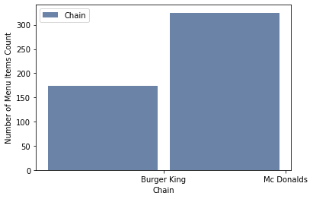
Histogram of items by Chain

Slide 7
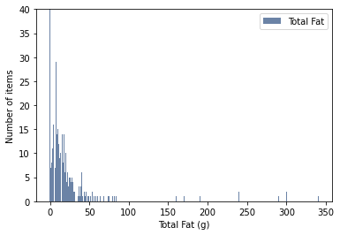
Histogram of Total Fat in Menu items TotalFat mean 17.498997995991985 TotalFat Variance 1509.87299096184 TotalFat Std 38.857084179874334

Slide 8
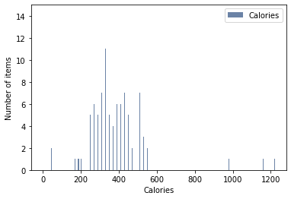
Plot of Calories per Menu item Calorie mean 305.73346693386776 Calories Variance 58526.79026325749 Calorie Std 241.9231081630225

Slide 9
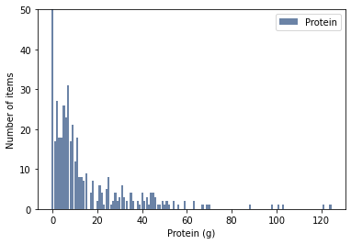
Plot of Protein per menu item Protein mean 12.254509018036073 Protein Variance 312.2423240054403 Protein Std 17.67037984892912

Slide 10
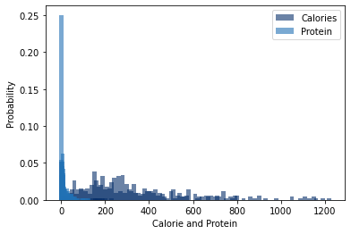
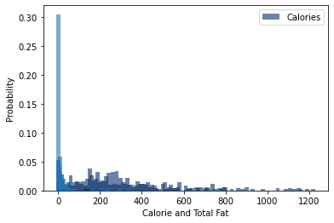
Probability and PMF
PMFs allow us to look the probability of certain values, we can see that probability with a 0 to 100 scale. Several PMFs on the data set were calculated and two plots comparing calories to protein or fat content can be seen to the right. We can see that Calories has several 0 calorie items. This is likely due to the sauces or drinks on the many that have no nutritional value. This could be seen as extra data that we would want to potentially remove.

Slide 11
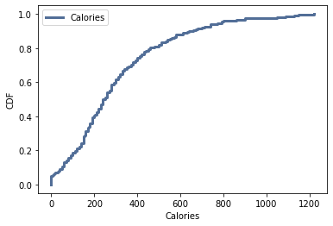
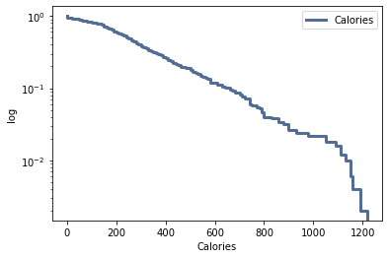
CDFs on Calories
CDF or cumulative distribution functions allow us to track the number of items with a certain value in relation to the number 1 being 100%. We see the calorie distribution on the top left where many items have 0 calories, and most sit around 100-600. There are a few items, about 30% according to the CDF calculation, that are over 600 calories.

Slide 12
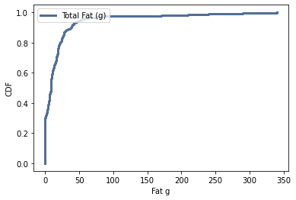
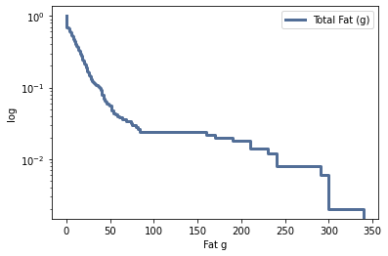
CDFs on Fat
When looking at the CDF of fat, we see that most of the values are under 100 calories, 86.7 %. It is hard to see the differentiation of fat count as the value goes up, so a logarithmic scale, the chart on the bottom, helps us see the trend.

Slide 13
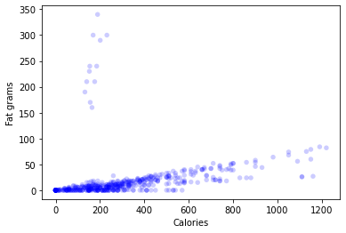
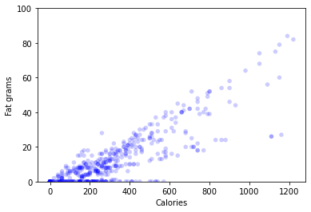
Scatter plots of fats and calories
The scatter plot to the right shows the spread of the fat content of all the menu items from burger king and McDonalds compared to the calorie content. This is around 480 data points, and we are starting to see a correlation. There appears to be some trend between the two, and it is coming from outliers in the fat content. We can try to see the correlation between the two using a Pearson’s and Spearman's correlation analysis. The correlation study brought us a corr value of 0.24 and Spearman's showed 0.70. There may be something there, but it is not obvious.

Slide 14
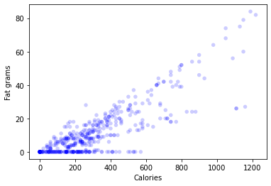

Further Analysis on Fats vs Calories
Although our correlation numbers are low, the graph looks like there may be something there. I do notice many outliers in the data set that are lower in calories and high in fat. I identify that these are coming from breakfast items that include sausage and bacon. I can remove them from the dataset to get new correlation numbers. I see that my Pearson correlation goes from 0.24 to 0.84, which is a might difference identifying there is a correlation between the two.

Slide 15
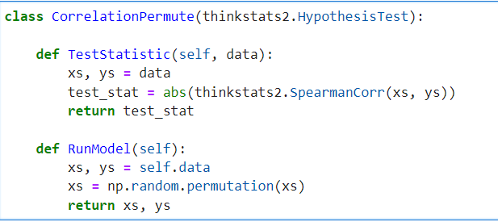
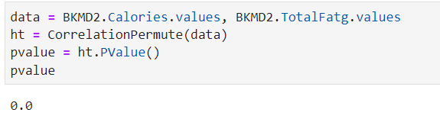
Testing a Correlation Permutation
One additional test I tried to perform on this dataset was a correlation permutation. This hypothesis testing method ended up with a 0 though, likely because the two values are on very different scales.

Slide 16
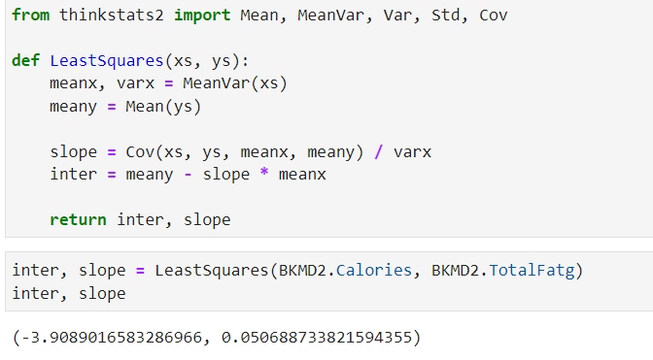
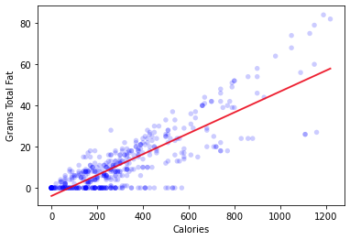
Line Fit
Although our permutation didn’t work out, we can perform a line fit on the two variables to identify if there is some linearity. The chart to the right shows that we do see a straight line identifying the slop and trend of the data. This is backing our hypothesis that these two tend to fit one another. Thinking back, many of the 0 fat items could be related to menu items that are drinks, and that could be skewing our correlation downward.

Slide 17
Regression Models
We can perform a regression analysis on the cleaned data set for Calories and total fat or protein content to see if there is a fit. The regression involving fat shows an R2 value of 0.71 which is a decent fit. For protein we get 0.24 which is much less, continuing the idea that Calories and fat are correlated but we don’t see that in some of the other notional facts.

Slide 18
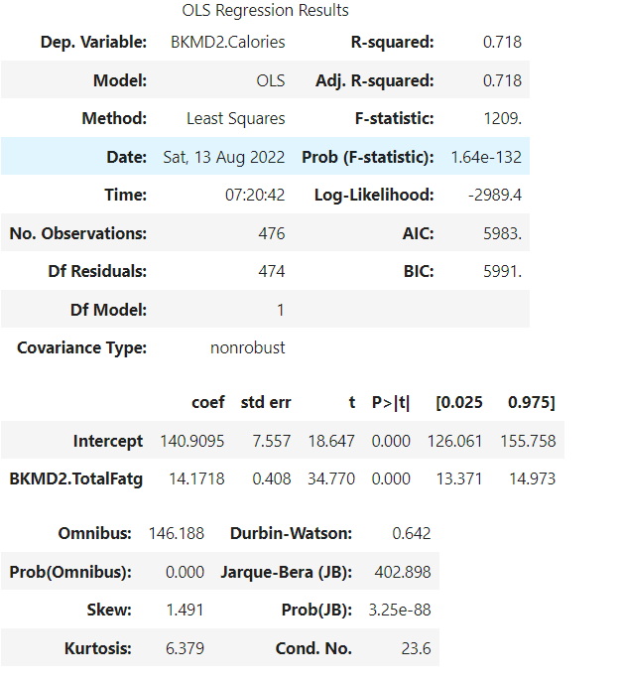
Regression Model 1 Calories and Total Fat g

Slide 19
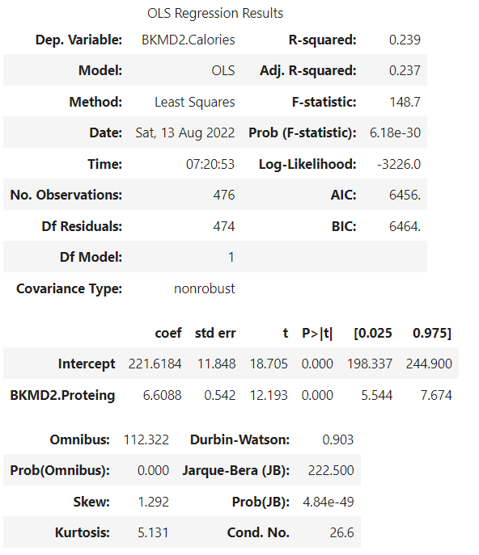
Regression Model 2 Calories and Protein

Slide 20
Mcdonalds and Burger King Menu EDA Conclusion
The Conclusion from our study shows a trend that calories and total fat in grams do have a correlation at two of our fast-food chains. Because we were looking at the entire menu, some of the other correlations were not as easy to make.

